Slide 1

WORLD BANK
Lessons from Procurement Cases in ECA Countries
Devesh C. Mishra, Regional Procurement Manager, Europe and Central Asia Region/World Bank
Istanbul April 2010

Slide 2
Background
Different lending instruments
A mix of investment lending and development policy lending
Fiscal 09:Out of USD 46.9 billion, ECA share was 20%( about US$9.5 billion)
Turkey accounted for US$ 5.82 billion( more than half): fifth largest borrower in the world

Slide 3
Red Procurement Guidelines vs Green Consultants Guidelines
Red Guidelines apply to all contracts for goods or works financed in whole or in part from Bank loans
Green Guidelines apply to consulting services of intellectual and advisory nature
Both Guidelines mandate use of Standard Bidding Document/Request For Proposal document

Slide 4
Common Issues: Goods
Responsive Bids
Procurement Guidelines and SBD require that bids containing material deviation or reservations to the terms and conditions and specifications of the bidding document be not considered for evaluation and award

Slide 5
Bidding Document: Goods
Need to study carefully:
Raise issue of ambiguity, contradiction , omission etc, prior to submission of bids/proposal. In case o f consultancy assess if requirements of TOR and commercial and contractual condition be met
Restrictive, or tailored technical specifications:
limit the competition resulting in significant differences in the qualities of the offered goods and hence significant differences in bid
Unrealistic requirements regarding the performance of the equipment and the respective warranties:
Bidders should carefully review the BD's and if there are such requirements to ask for clarification within the period indicated in the ITB.

Slide 6
Common Issues: Goods
Joint Ventures - ICB Goods
A consortium is not the same as a Joint Venture. JV's should be jointly and severally liable for the contract implementation. In this regard and given the nature of the procurement of goods, the establishment of JV's is not too appropriate for supply of goods. The suppliers should carefully review the qualification requirements before the bids preparation and bidding and if they have some questions to ask the purchaser for clarifications.
Qualification requirements and post-qualification
If the qualification requirements are not clear, this may result in misunderstandings and problems in the process of post qualification and may affect the final contract award. Therefore, any ambiguities should be clarified through clarifications within the period indicated in the ITB.

Slide 7
Common Issues: Goods
Alternative solutions and their evaluation - if alternative solutions are allowed, the bidders should carefully examine the methodology for their evaluation before making a decision to propose (or not) an alternative.
Bank guarantees: bid validity: performance securities, terms, amounts, omissions of important provisions The format of the bid security shall be in accordance with the standard bidding documents

Slide 8
Common Issues: Works
1. Eligibility and CoI issues; State-owned enterprises participating in tenders, confirming they operate under commercial law, yet are dependent of the Borrower or agencies of Borrowers participate in tenders which is not in compliance with eligibility provisions. Bidders are related to designer, bidder participates in a design.
Bidders should consider the eligibility requirements in the BD’s and legal and financial status, and also previous activities (including those of the affiliates and other member of a JV).
2. Bank guarantees /discount issues: JV ( e.g. bidder X is not on the name of JV or only on the name of one member); less validity period than requested in the Bidding Documents. Treatment of discount given by one partner only.

Slide 9
Common Issues: Consultants Services
Eligibility and COI issues; Unfair Competitive advantage, civil servants working for the implementing agency, conflict with previous assignments, state-owned enterprises .
Poorly prepared Terms of Reference (TOR) (unclear scope of services; terms for implementation, downstream works etc.) and significant differences in the prices.

Slide 10
Common Issues: Consultants Services
Negotiations in consulting services: Scope, deliverables, methodology, time, etc. tax obligations, responsibilities of the parties. No negotiation on rates, in general.
Failure of Negotiation: Instances where firm starts to question TOR or raise new deviations to contract conditions
Delays in Payments: Delays in the acceptance of the deliverables. Raise the issue with the Client and then with the Bank

Slide 11
Common Issues
Contract implementation: ( goods of lower quality supplied than as required by the Bidding Documents, enforcement of liquidated damages, low quality of supervision)
Contract Implementation: Bidders quote low prices and undertake contract unrelated to their capacity. Several examples non-performance , project delays and disputes

Slide 12
Common Issues
Joint Ventures between foreign firms and local firms: Local firms establish JV’s with foreign firms just for the purposes of short-listing or passing the qualification or post-qualification requirements. After signing the contracts, foreign firms delegate most of the tasks (civil works or consultancy) to local contractors or consultants although they are members in charge. This results in delays and poor quality of the deliverables.

Slide 13
Common Procurement Issues
Contract Implementation:
Bank is not a party to the contract. Contract implementation is the responsibility of the Employer. Bank can use its best efforts to request the Employer to enforce the provisions of the contract, but can not act as mediator in case of dispute. Bidders and consultant to follow dispute resolution mechanism as provided in the contract

Slide 14
Common Issues
Confidentiality: The process of bid evaluation is confidential until publication of award
Complaints Review: Bidder to contact the purchaser/client. If bidders wishes to ascertain the ground on which its bid was not selected for award, they may seek explanation from the purchaser
Debriefing: If bidder is not satisfied with the explanation given by the purchaser they seek meeting with the Bank. The purpose of such meeting is to only to discuss the bidder’s bid and neither to reverse the Bank’s position that has been conveyed to the Borrower nor to discuss the bids of competitors

Slide 15
IBRD/IDA Largest Borrowers
 | 2008 ($ billion) | 2009 ($ billion)
1 | India | India
 | 13,708 | 14,945
2 | China | China
 | 9,770 | 10,357
3 | Turkey | Brazil
 | 5,539 | 8,036
4 | Brazil | Indonesia
 | 5,084 | 6,584
5 | Vietnam | Turkey
 | 4,617 | 5,829
6 | Argentina | Argentina
 | 3,999 | 5,786
7 | Nigeria | Vietnam
 | 2,962 | 5,470
8 | Indonesia | Nigeria
 | 2,927 | 4,067
9 | Colombia | Mexico
 | 2,886 | 3,949
10 | Ethiopia | Pakistan
 | 2,715 | 3,579

Slide 16
Turkey Projects – Human Development
Project Name | Closing Date | Total Amount (US$ ml)
Health & Social Security Reform | 7/31/2013 | 75
Health Transition | 12/31/2009 | 48
Privatization Social Support II | 10/31/2009 | 445
Secondary Education | 12/31/2010 | 104

Slide 17
Turkey Projects – Sustainable Development
Project Name | Closing Date | Total Amount (US$ ml)
Anatolia Watershed | 6/30/2012 | 23
Avian Flu | 11/30/2010 | 34
ECSEE APL 2 | 12/31/2010 | 66
ECSEE APL 3 | 6/30/2011 | 150
Electricity Distribution | 12/31/2012 | 269
Electricity Generation | 12/31/2011 | 336
Gas Sector Development | 12/31/2012 | 325
Istanbul Municipal Infrastructure | 12/31/2011 | 322
Land Registration & Cadastre | 9/30/2013 | 203
Municipal Services | 6/30/2010 | 275
Private Sector RE & EE | 12/31/2014 | 500
Railways Restructuring | 6/30/2012 | 185
Seismic Risk Mitigation | 9/30/2010 | 400
Project Name | Closing Date | Total Amount (US$ ml)
Health & Social Security Reform | 7/31/2013 | 75
Health Transition | 12/31/2009 | 48
Privatization Social Support II | 10/31/2009 | 445
Secondary Education | 12/31/2010 | 104

Slide 18
Turkey Projects – Private and Financial Sector Development
Project Name | Closing Date | Total Amount (US$ ml)
Access to Finance for SMEs | 4/30/2012 | 447
Export Finance Intermediary Loan (EFIL) IV | 6/30/2013 | 600

Slide 19
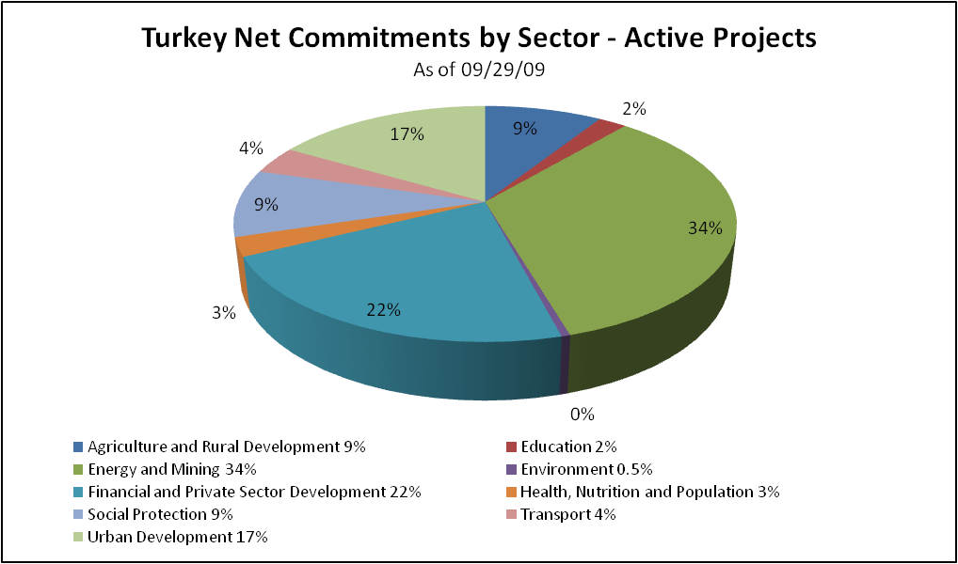
Turkey Projects – Portfolio Composition
Project Name | Closing Date | Total Amount (US$ ml)
Access to Finance for SMEs | 4/30/2012 | 447
Export Finance Intermediary Loan (EFIL) IV | 6/30/2013 | 600

Slide 20
Turkish Contractors’/Suppliers’/Consultants’ Procurement from Bank Projects*
Year | Within Turkey | Outside Turkey | Total
 | US$ | US$ | US$
 | Millions | Millions | Millions
2003 | 96.738 | 71.625 | 168.363
2004 | 137.584 | 18.529 | 156.113
2005 | 184.702 | 59.080 | 243.782
2006 | 188.476 | 41.943 | 230.419
2007 | 310.647 | 24.401 | 335.048
2008 | 344.204 | 158.410 | 502.614
27-Jul-09 | 68.514 | 82.850 | 151.364
∑ | 1,330.865 | 456.838 | 1,787.703

Slide 22
Share of Turkish Contractors’/Suppliers’/Consultants’ Procurement from Bank Projects Outside Turkey (US$ Million)
Country | 2003 | 2004 | 2005 | 2006 | 2007 | 2008 | 2009 | Total
Afganistan | 60.468 | 13.487 |  |  |  |  |  | 73.955
Albenia |  |  | 0.408 |  | 0.024 | 0.177 |  | 0.609
Azerbaijan | 7.122 | 1.334 | 5.327 | 33.363 | 0.542 | 32.409 | 70.439 | 150.536
Bangladesh | 0.231 |  | 42.136 | 0.460 | 1.317 | 0.994 |  | 45.138
Bulgaria |  |  |  |  | 4.150 | 0.603 |  | 4.753
Congo, Dem.Rep. | 0.644 |  |  | 0.660 |  |  |  | 1.304
Eritrea |  |  |  | 0.224 |  |  |  | 0.224
Ethiopia |  |  |  |  |  | 63.195 |  | 63.195
Georgia |  | 0.102 |  | 3.831 | 1.936 |  | 12.366 | 18.235
India |  |  |  |  |  | 11.161 |  | 11.161
Indonesia | 0.023 |  |  |  |  |  |  | 0.023
Iran |  |  |  |  |  | 1.963 |  | 1.963
Iraq |  |  |  |  | 2.138 | 34.873 |  | 37.011
Jordan | 0.257 |  |  |  |  |  |  | 0.257
Kosovo |  |  |  |  |  | 0.026 |  | 0.026
Krgyz Rep. |  | 1.465 | 1.284 |  | 4.840 | 1.035 |  | 8.624
Macedonia | 0.166 |  |  |  |  |  |  | 0.166
Moldova | 2.139 | 0.341 | 7.374 |  |  |  | 0.046 | 9.900
Montenegro |  |  |  |  |  | 10.347 |  | 10.347
Pakistan |  |  |  |  |  | 0.013 |  | 0.013
Romania | 0.575 |  |  | 1.700 | 8.904 | 0.828 |  | 12.007
Sudan |  |  |  |  | 0.107 |  |  | 0.107
Tajikiskan |  |  | 0.880 | 1.705 | 0.056 | 0.025 |  | 2.666
Ukraine |  |  | 1.083 |  |  |  |  | 1.083
Uruguay |  |  | 0.588 |  |  |  |  | 0.588
Uzbekistan |  |  |  |  | 0.386 | 0.761 |  | 1.147
Yemen |  | 1.800 |  |  |  |  |  | 1.800
∑ | 71.625 | 18.529 | 59.080 | 41.943 | 24.400 | 158.410 | 82.851 | 456.838

Slide 23
Thank You!
Questions and Answers

